Slide 1
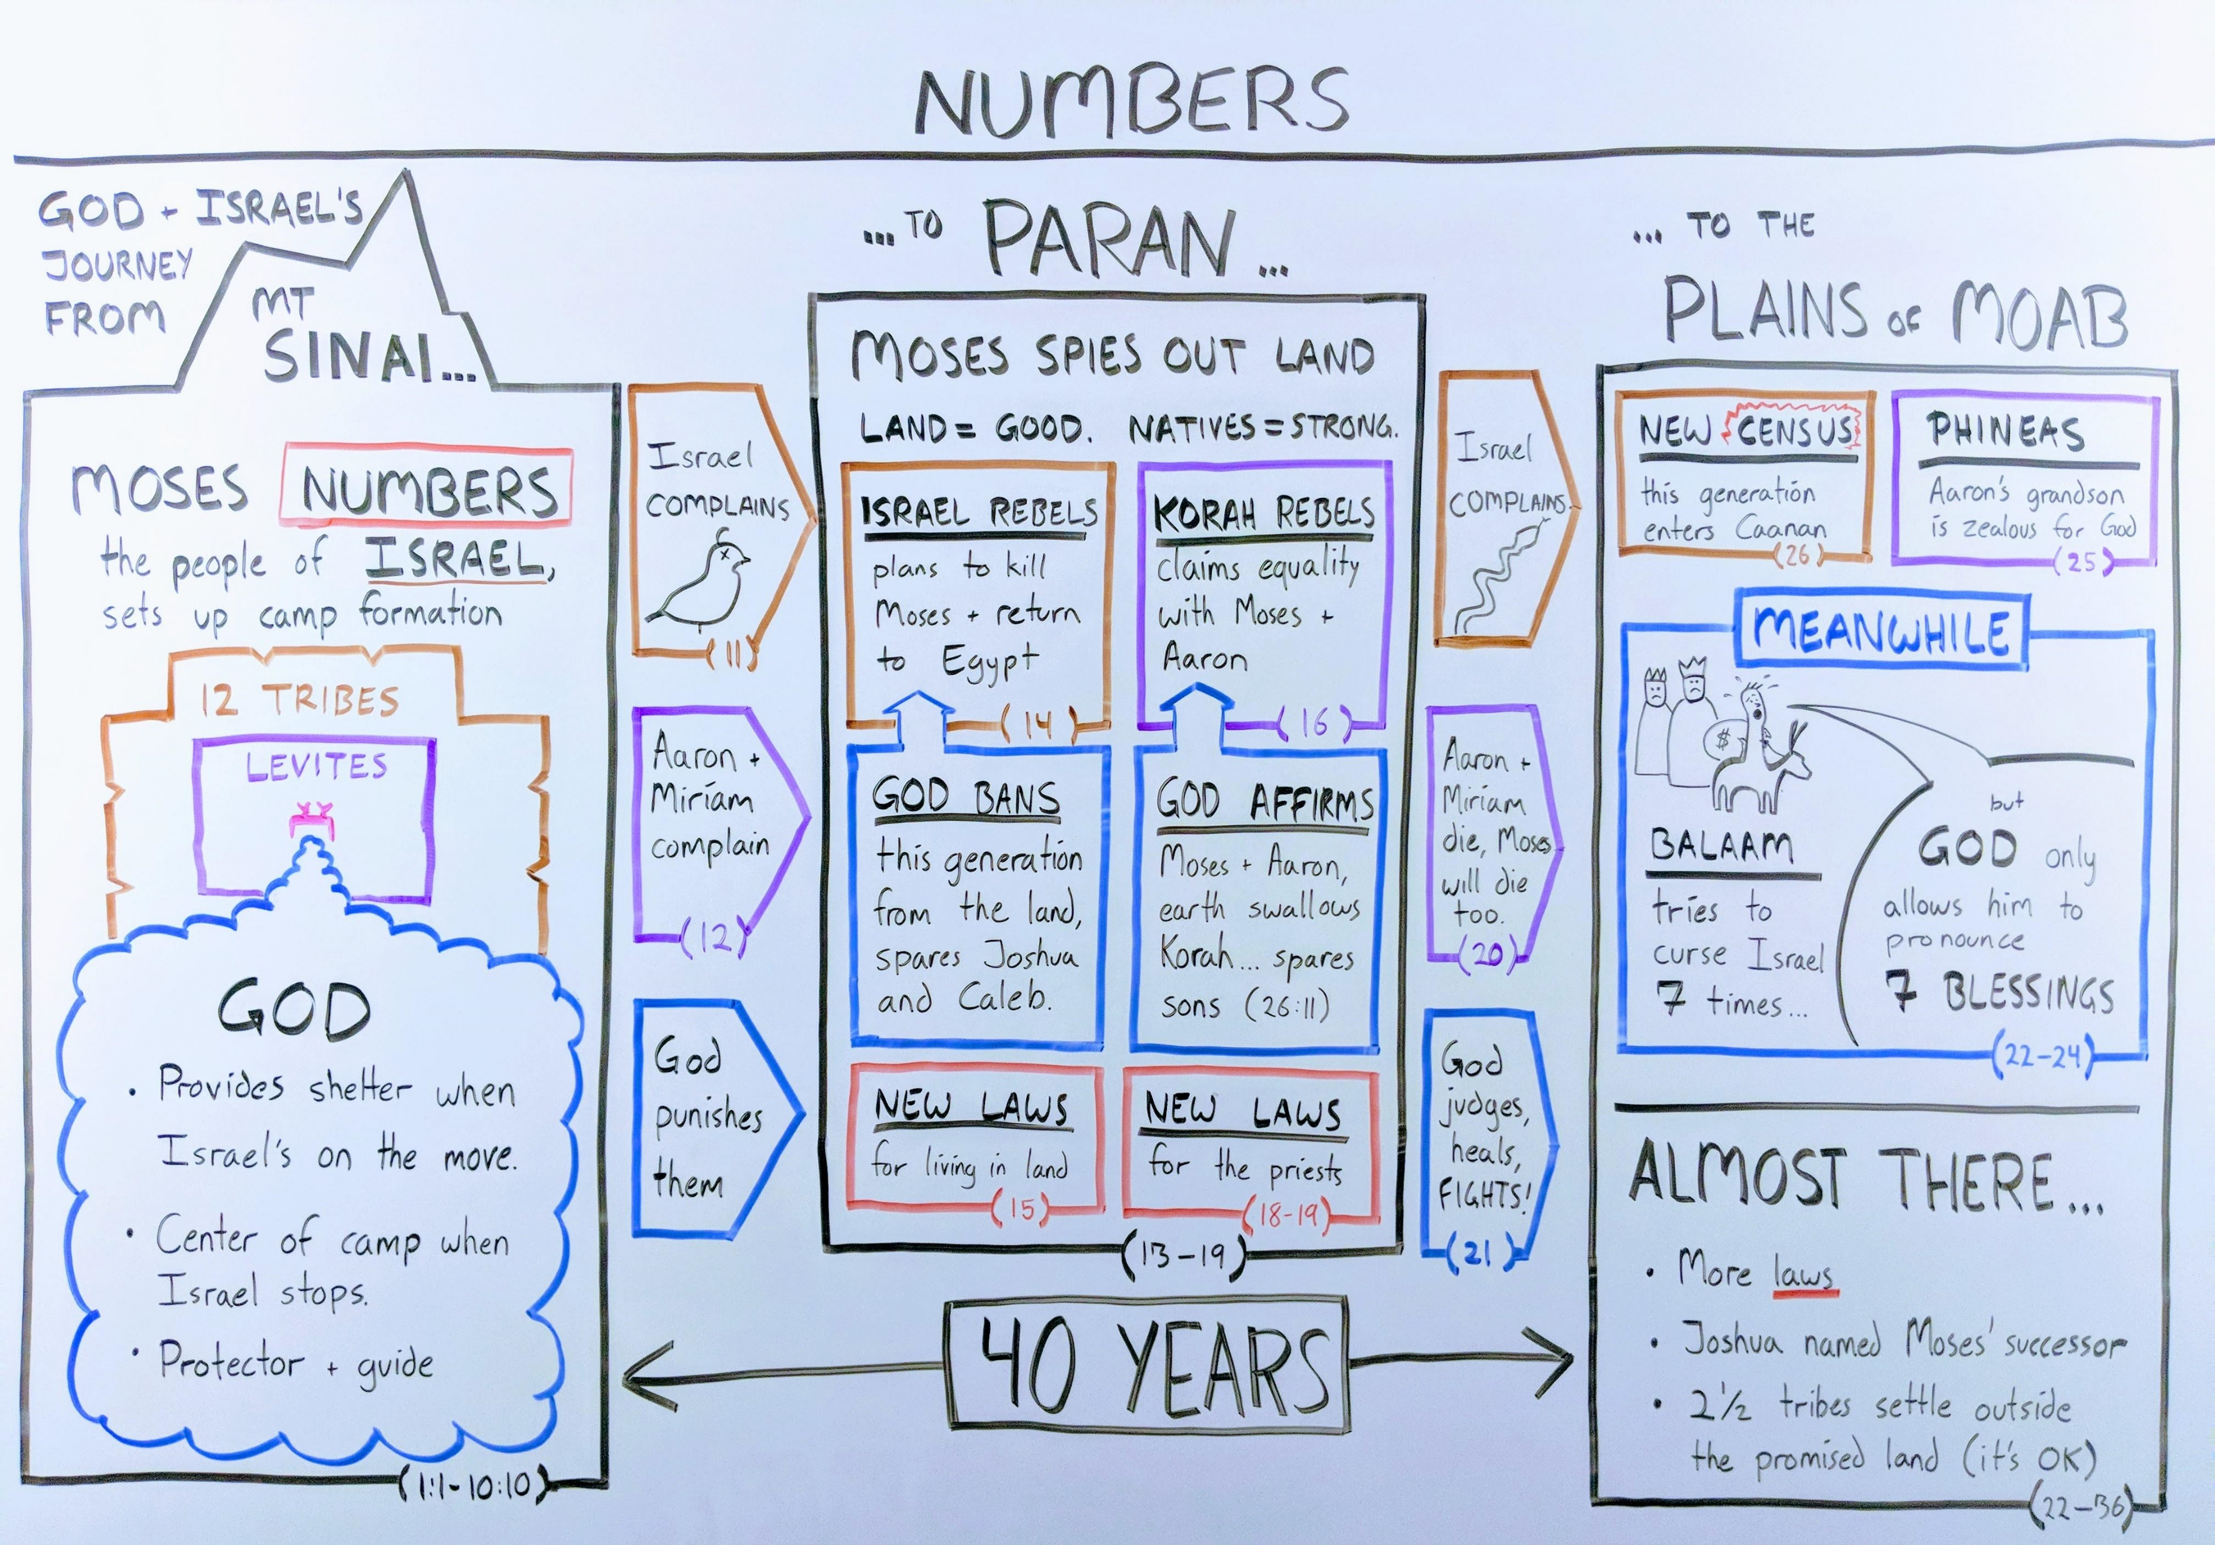
God Is Government
Isaiah 33:22
“For the LORD is our judge, the LORD is our lawgiver, the LORD is our KING; he will save us.”

